Slide 1
For Live Session
Unit 5
Chad Madding

Slide 2
DELTTAA
Data: The OTP used in this project is a daily metric, determined by the number of arrival on-time flights vs. total number of scheduled flights per day, following the 15-minuteon-time rule.
Enterprise: a data science/operation research consultancy group
Leadership: My internal customers/stakeholder

Slide 3
DELTTAA
Targets: breaking the ground for predictive analytics in airline operation using weather
Technologies: Python, R and Tableau for the dashboards.
Analytical Techniques: weather prediction, Querying external data, Multivariate Linear Regression and Lasso
Analysts: Providing decision-driven insights

Slide 4
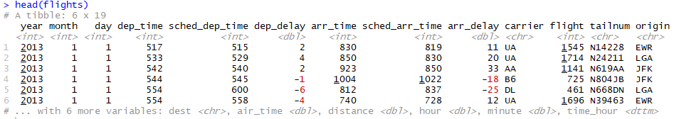
For Live Session
Create a new data set in R or Python (or Tableau) that calculates On Time Performance (OTP) for Delta (DL), American (AA) and Southwest (WN) Airlines for each day. Show the head of this data with a screen shot.

Slide 5
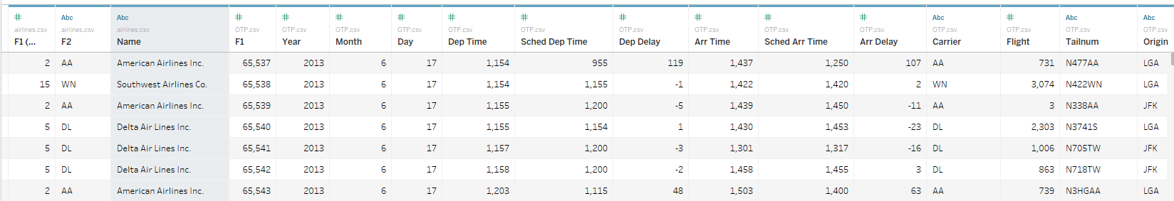
For Live Session
In DS 6306 (DDS) we discussed merging and joining datasets. In Tableau, merge the data set you created with the airlines data frame to create one data set that includes the date (by day), the carrier, the flight number, the on time performance (otp) and the airline name. Show the head of this dataset with a screen shot.

Slide 6
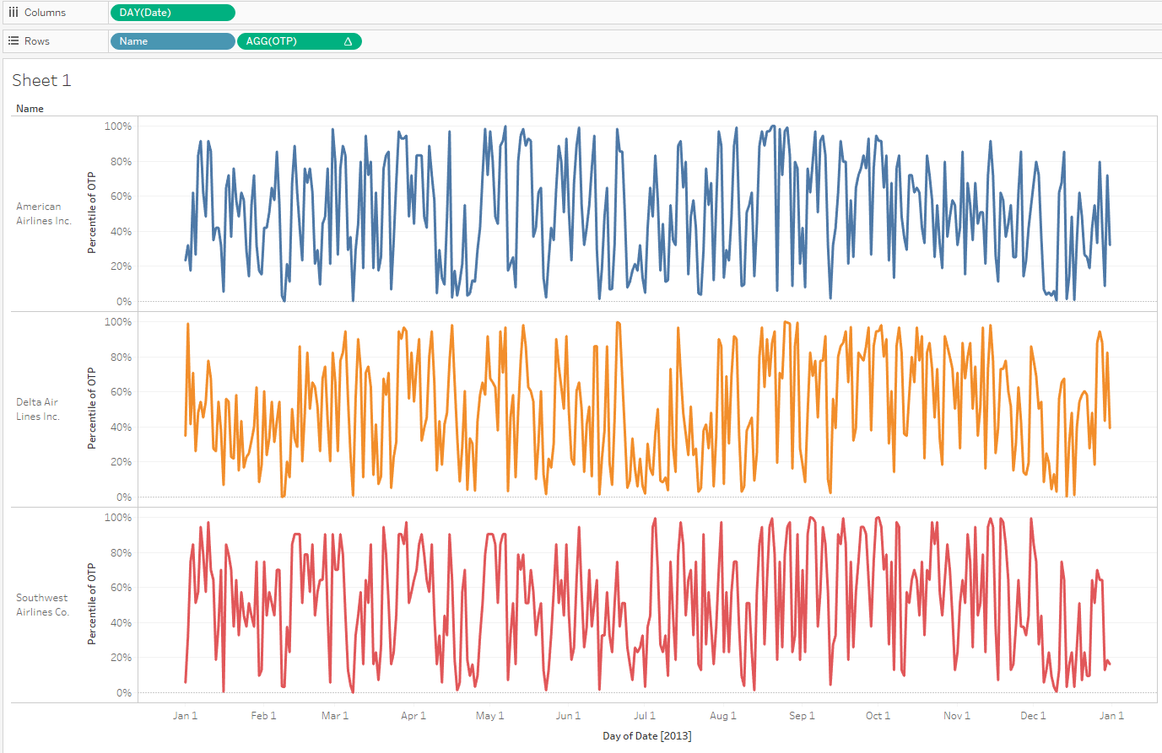
For Live Session
In Tableau, create a time series plot of OTP with a separate series for each airline. To be clear, there should be three time series plots (color coded) on the same coordinate plane with OTP on the y axis and time (in days) on the x-axis. Provide a screen shot of this plot and be prepared to share you Tableau workbook in class.

Slide 7
For Live Session
What inference / insights can you get derive from these plots?
One of the major things that I noticed was that they all 3 seemed to follow a pattern. The 3 airlines would have highs and lows on almost the same day. It would be interesting to look at some other overlying data like weather on some major news stories.

Slide 8

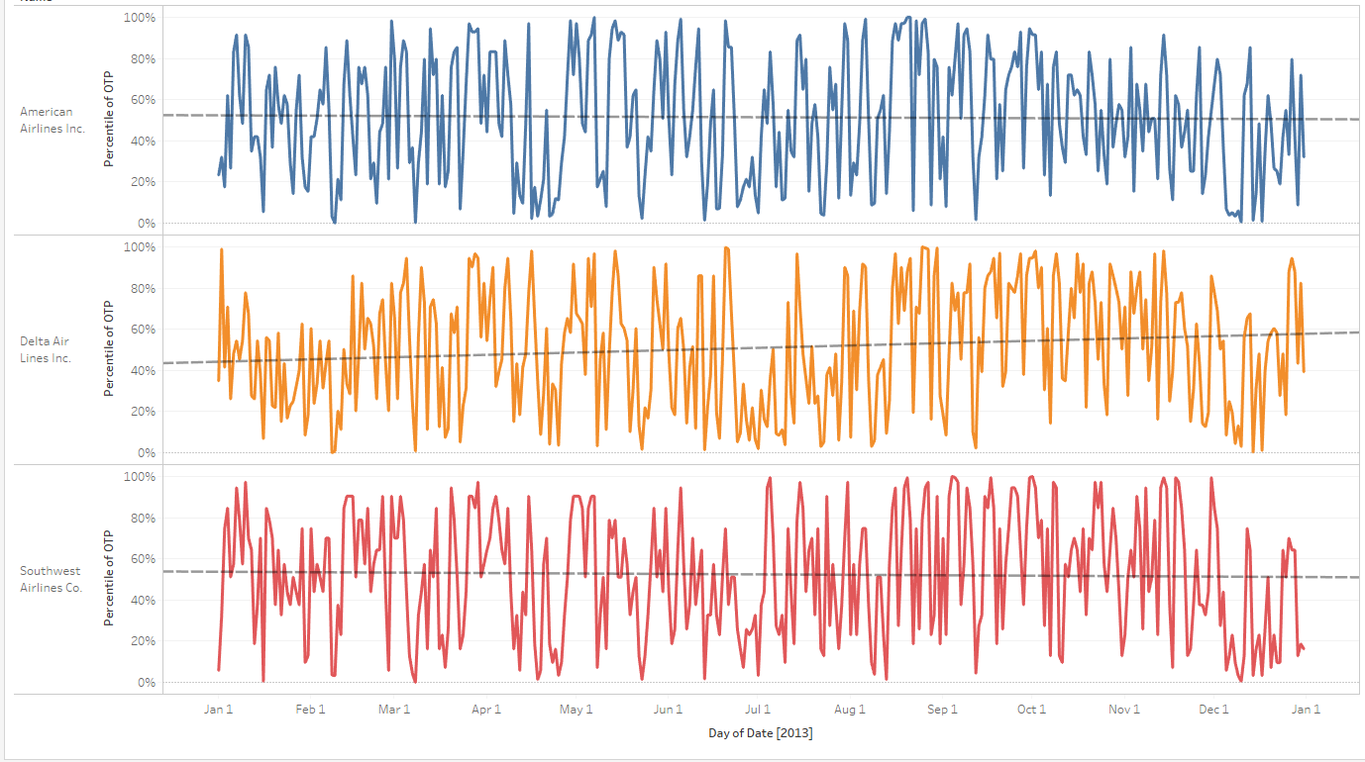
For Live Session
Use Tableau to forecast (and plot) the next week (7 days) of OTP. Hint: Check out the Analytics Tab. Can you provide any additional insight? Provide a slide with a screen shot of this plot and include any additional insights. Also, research and find out what type of forecast Tableau is providing here.
Looking at the trend lines you can see over the next 7 days that Delta is on a significant up swing where Southwest and American should stay the same.
Looking at the Analysis Of Variance we can see that the findings are very significant.

Slide 9
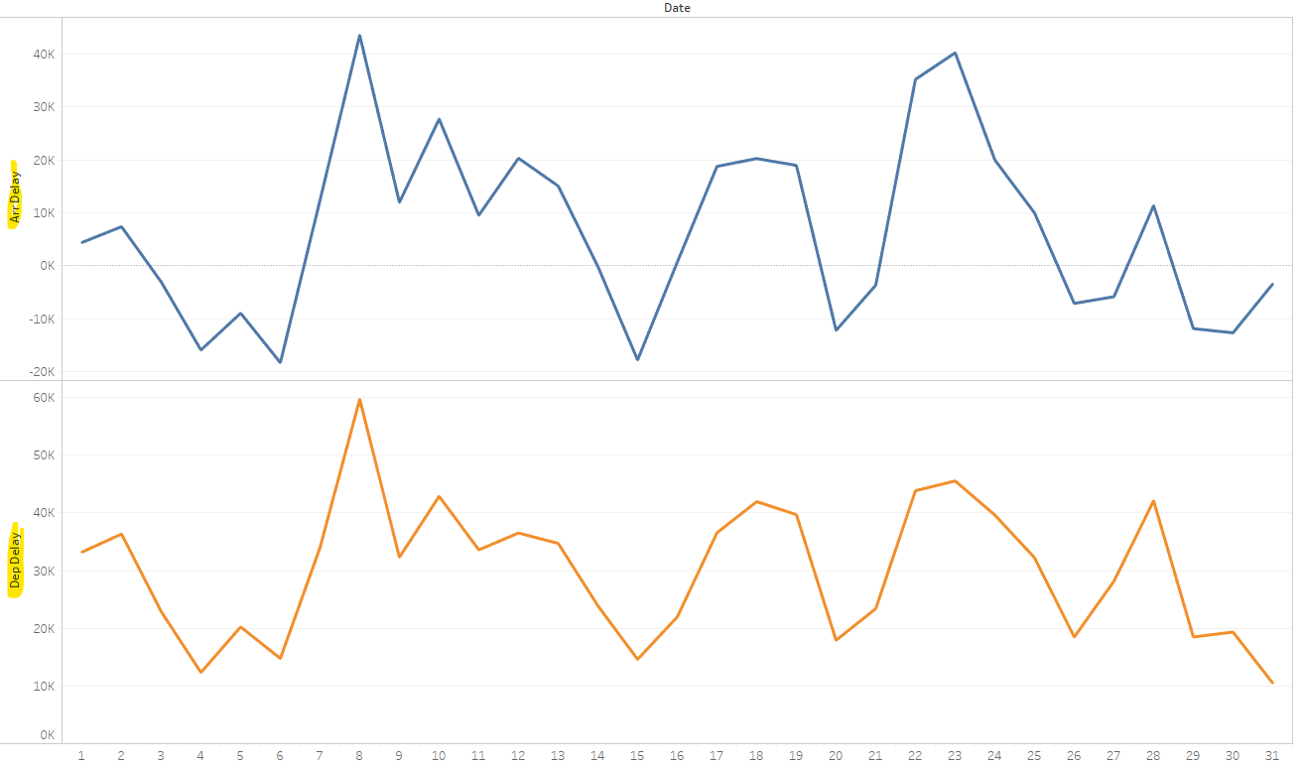
For Live Session
Use the data sets in the nycflights13 R package and Tableau to create a plot / analysis of something you find interesting! What inference/ insight do you derive from this analysis?
One thing that seemed very significant to me is the correlation between arrival and departure delays. This would of course make since because a plane that arrives late would leave late. This might be an area for improvement. We maybe able to pick up some time be turning around late planes faster.

